Slide 1
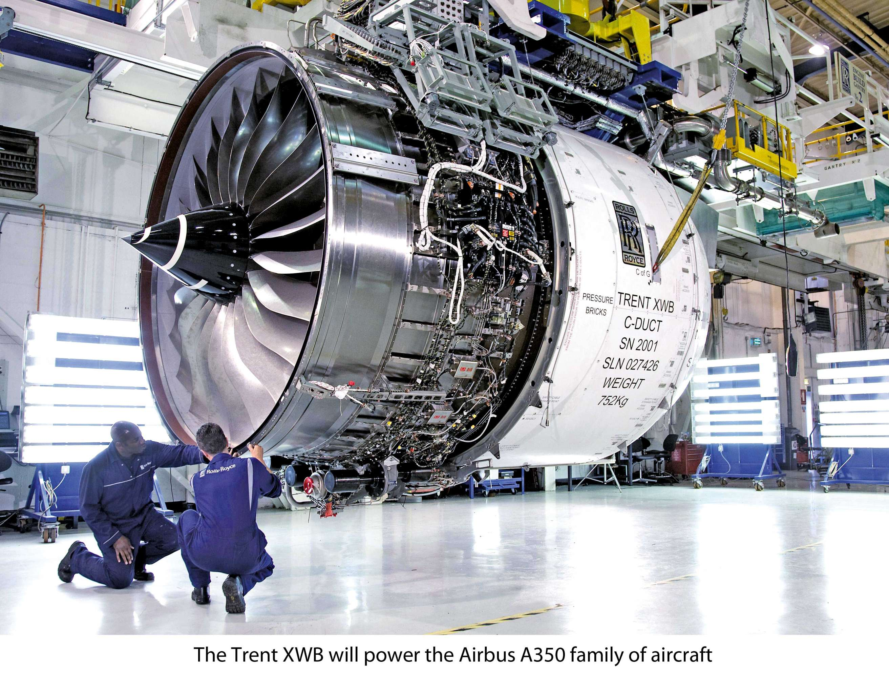
Predictive maintenance use case
NASA Dataset

Slide 2
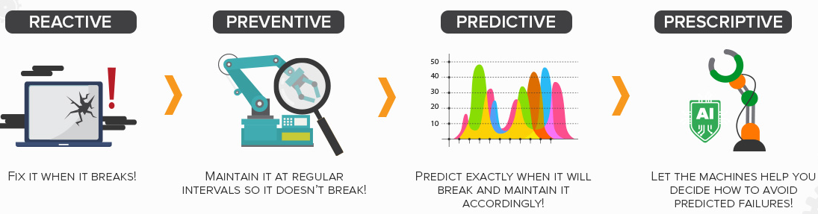
The long path from reactive to prescriptive
Businesses are already using continuous monitoring technologies - like Internet of Things (IoT) connected devices; but the key lies in not just simply monitoring the output of various data (which is how many companies use it today), but in taking the next step and employing advanced algorithms and machine learning to take action from real-time insights.

Slide 3

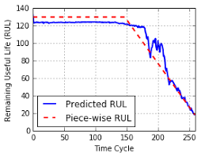

Dataset description
Dataset contains 100 engines running to fail 6 times
3 times will be use for training and 3 times for testing
Every engine have 21 sensors and 3 op settings
Sensor data
6.735.078 Datapoints

Slide 4
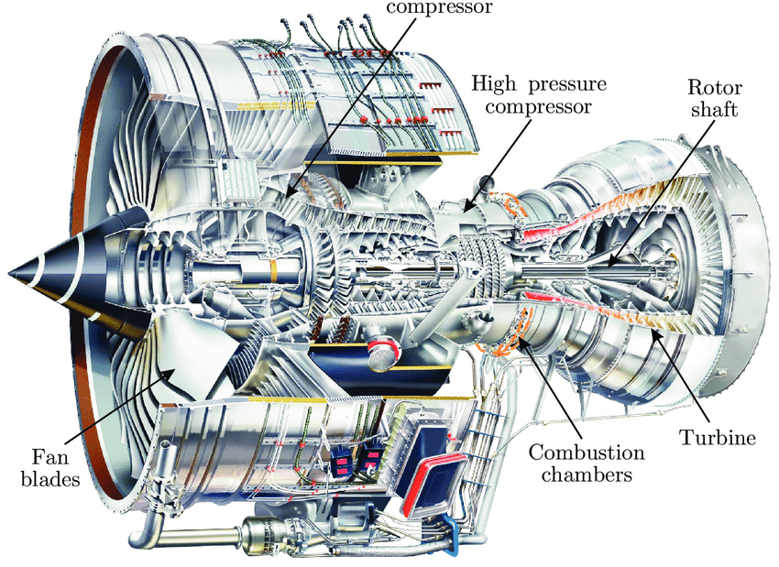
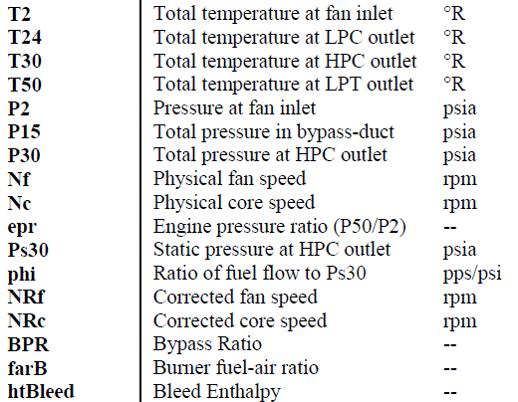
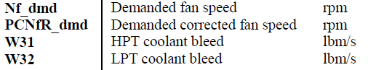
Dataset description
Dataset contains 100 engines running to fail 6 times
3 times will be use for training and 3 times for testing
Every engine have 21 sensors and 3 op settings

Slide 5
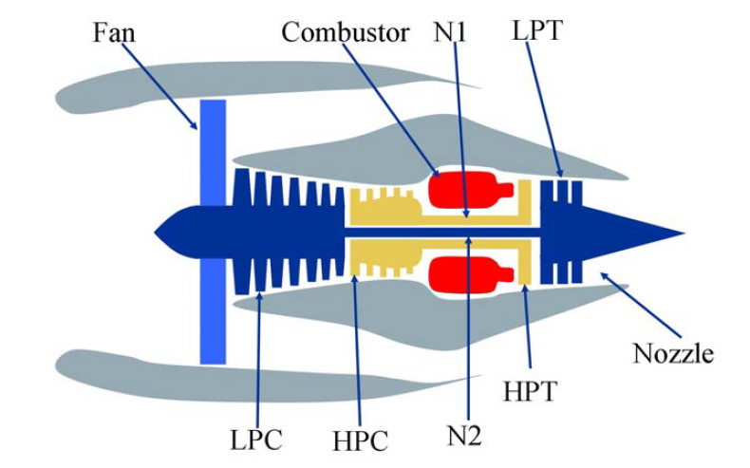
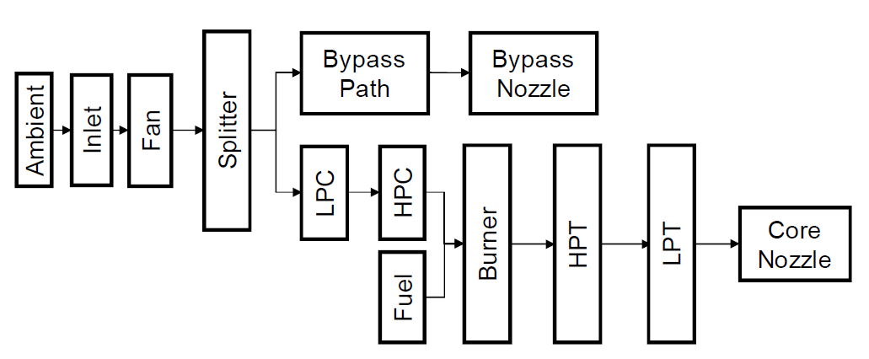
Simplified diagram of an engine
Simplified diagram of engine simulated in C-MAPSS
A layout showing various modules and their connections as
modeled in the simulation

Slide 6
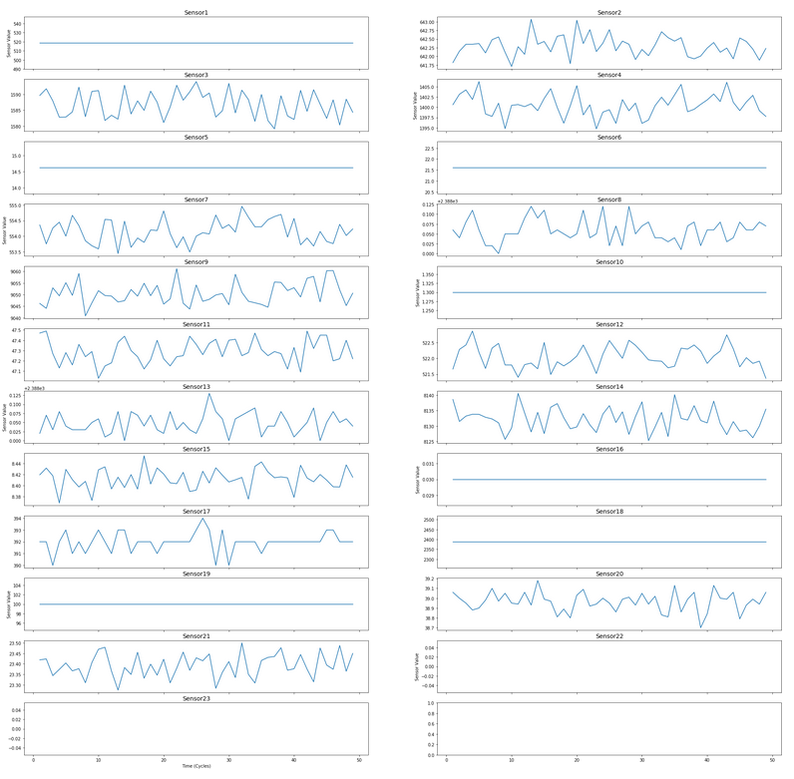
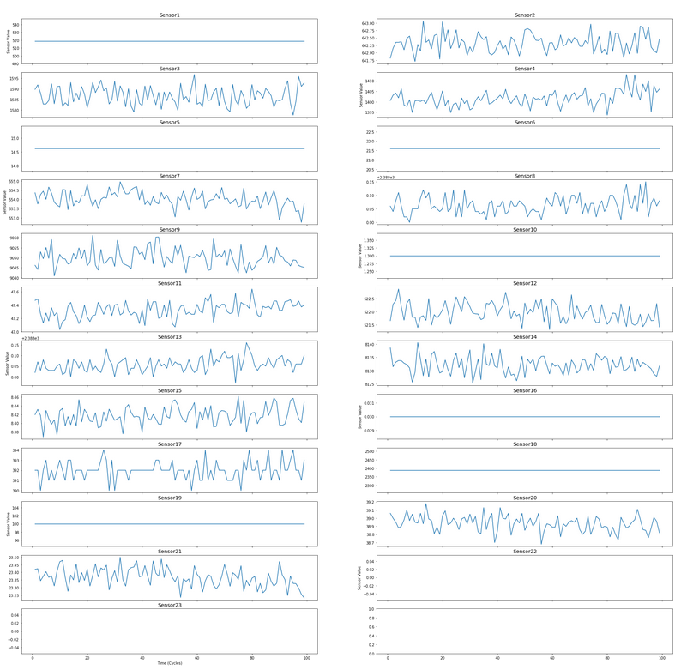
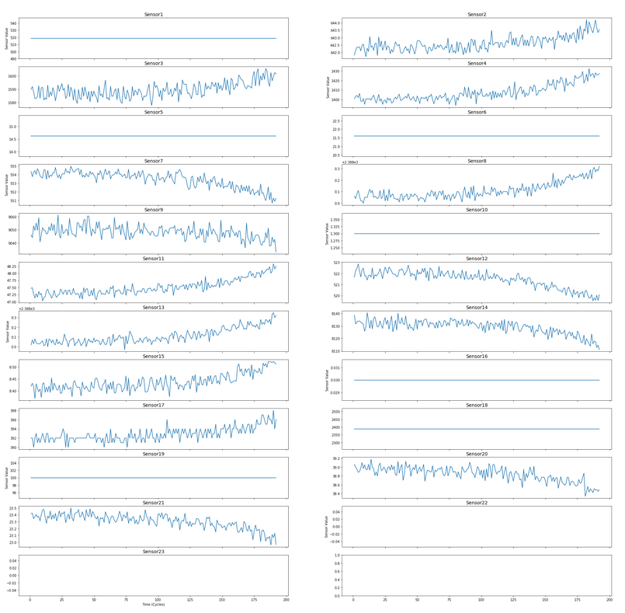
Trend for engine 1
First 50 cycles
First 100 cycles
First 200 cycles

Slide 7
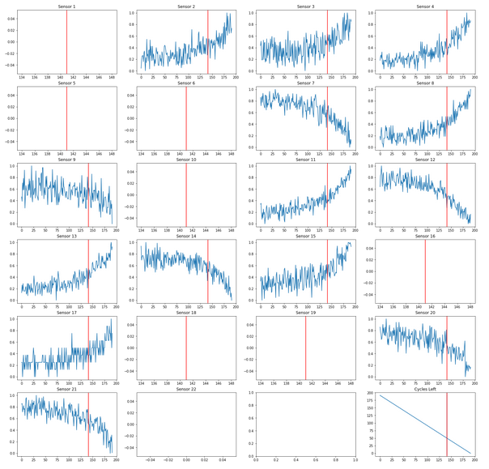
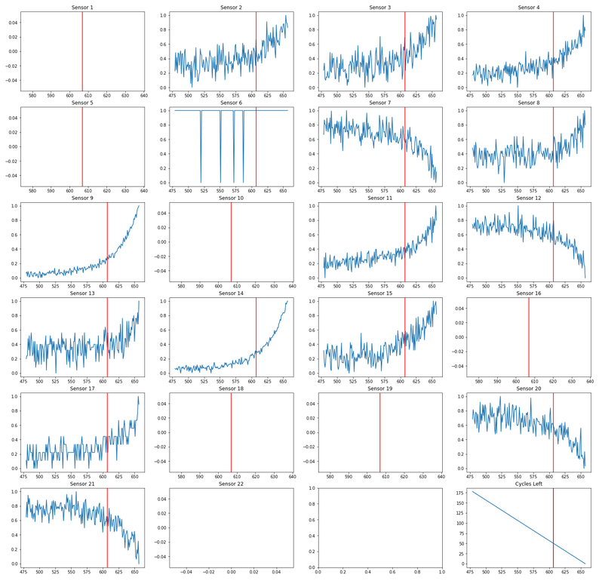
Comparison Engine 1 with Engine 2

Slide 8
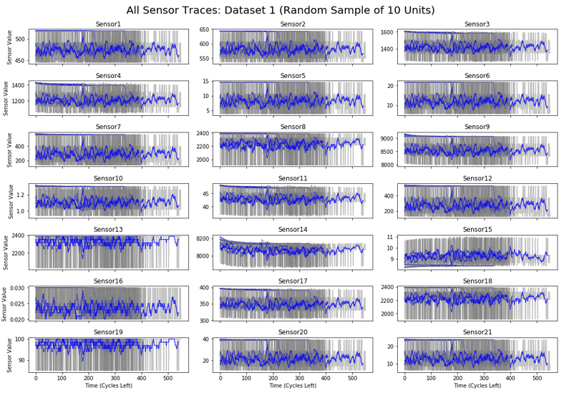
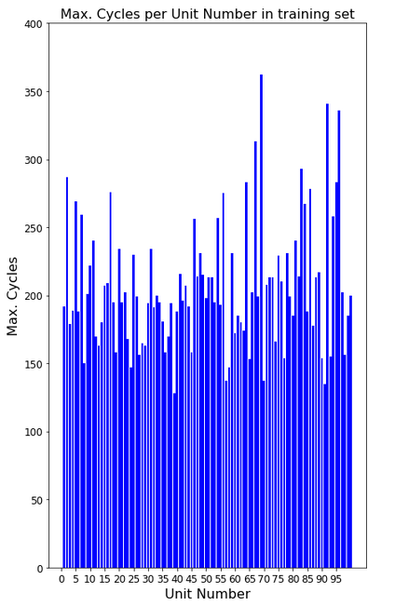
10 random engines overlapped and aligned

Slide 9
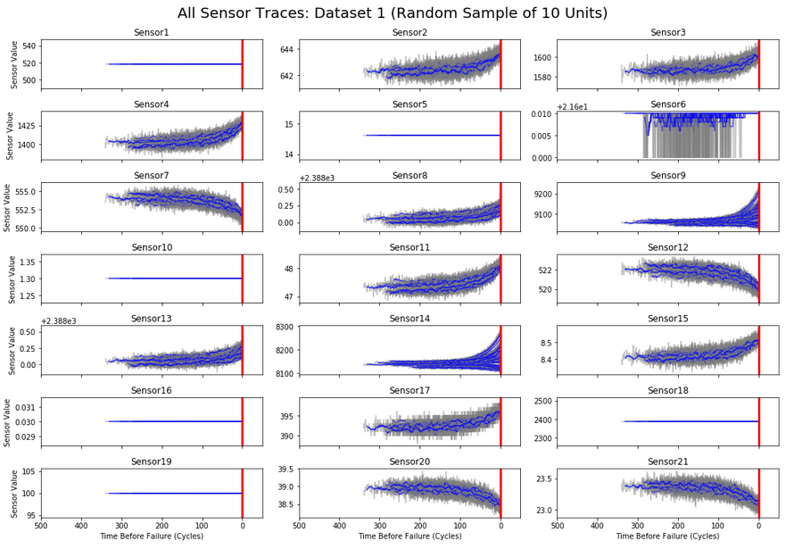
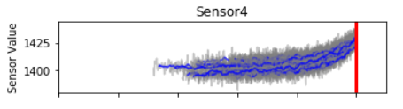
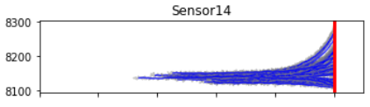
Overlapped machines base on “Cycles left”

Slide 10
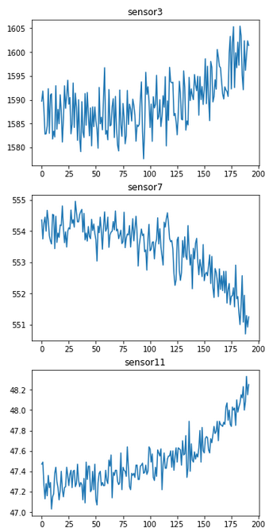
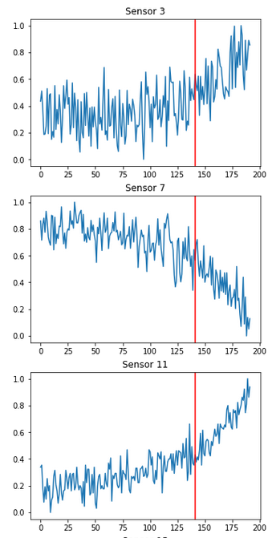
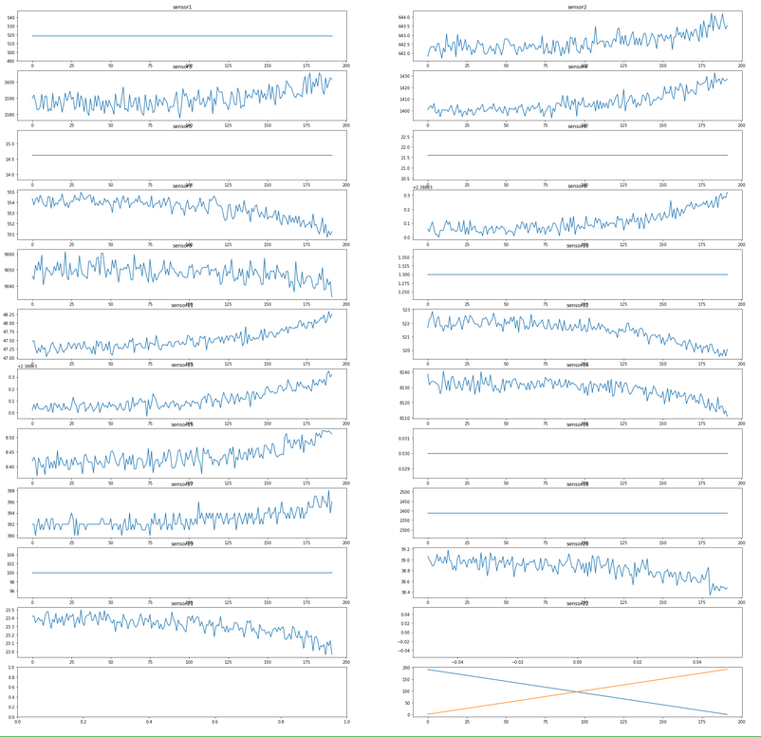
Feature engineering “Cycles left” and normalization
Cycles left

Slide 11
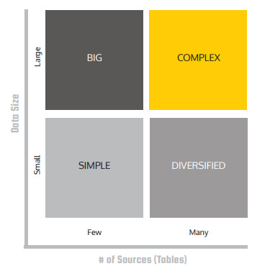
Data quality challenges in real world scenarios
Duplicate data
Missing values
Disordered Messages
Different time zones
Different formats for dates
Facts extraction from free text
Human errors or typos in log files

Slide 12
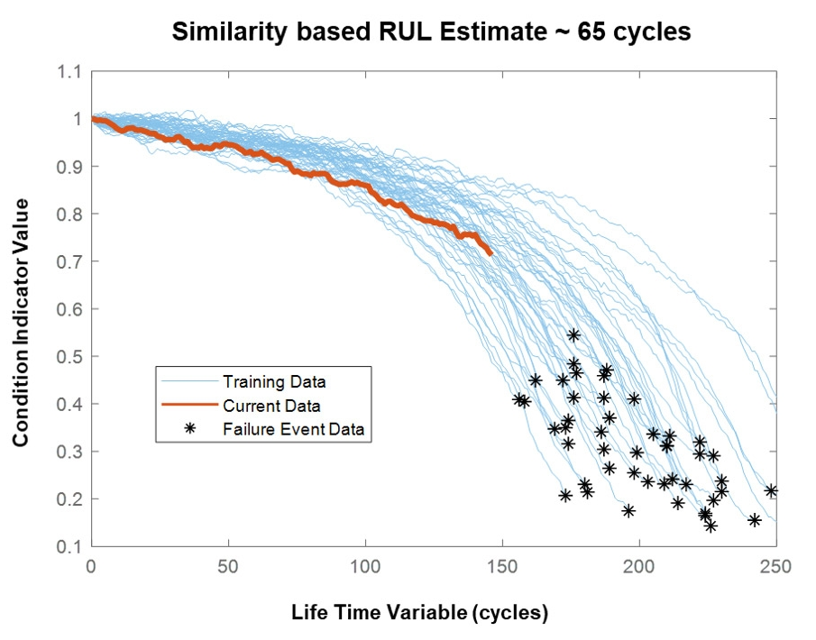
Prediction of RUL
The degradation profiles of historical run-to-failure data sets from an engine are shown in blue and the current data from the engine is shown in red.
Based on the profile the engine most closely matches, the RUL is estimated to be around 60 cycles.

Slide 13
Prediction of RUL
The degradation profiles of historical run-to-failure data sets from an engine are shown in blue and the current data from the engine is shown in red.
Based on the profile the engine most closely matches, the RUL is estimated to be around 60 cycles.

